Slide 1
Week 2. Niches and Distributions
A. Michelle Lawing, PhD
Associate Professor
Paleobiology, Evolution, and Climate Lab
Ecology and Conservation Biology
Texas A&M University
alawing@tamu.edu
Peterson, A.T., Soberón, J., Pearson, R.G., Anderson, R.P., Martínez-Meyer, E., Nakamura, M. and Araújo, M.B., 2011. Ecological niches and geographic distributions (Vol. 49). Princeton University Press.

Slide 2
Welcome, hello, any announcements?

Slide 3
Workshop Course
Last week moved quickly, and Lab 01 took longer than I anticipated
I want to provide some dedicated class time today to address questions, troubleshoot, and revise your work
Class work is code-based and iterative, so I’m wanting to get us set up with a simple workspace and workflow to code, track changes, document decisions, and share work
So RStudio, Git, GitHub Desktop, and GitHub

Slide 4
Class Plan
Today
Discuss programs and workflow for Lab 01
Workshop to revise and resubmit Lab 01
Read Peterson Chapter 3 by Thursday

Slide 5
Git, GitHub Desktop, and GitHub
R Project folder is where your code, data, README, and outputs exist on your personal computer
Git is a version tracker that records snapshots of changes in that folder (called a repository)
GitHub Desktop is the application that helps you easily commit and push to your online repository to share your work
GitHub is the online repository you can share

Slide 6
The basic workflow
Edit and save your script, README, or output
Check that the script runs fully from the top
In GitHub Desktop, review the changed files
Commit - save a named snapshot locally
Push - send that commit to GitHub
Open GitHub in a browser and confirm the files are there

Slide 7
Pulling
Pull brings changes from the GitHub version of your repository into the copy on your computer
In Github Desktop, select the correct repository
Click Fetch origin to check for online changes
If changes are available, click Pull origin.
Open the project in RStudio and confirm the new files are present
Good habits to start - pull before you start working and commit/push when you are done

Slide 8
RStudio
Four parts to consider
Project: establishes the working folder
Script: saved, reproducible instructions
Console: temporary place where code runs
Files pane: shows data, outputs, and project files
Write and save code in the script, then run it from the script. Results and errors show up in the console.

Slide 9
Objects and functions
occ_raw <- read.csv("data/crotalus_triseriatus_gbif_raw.csv")
occ_raw is the object name
<- assigns the result to that object
read.csv() is a function
Text in quotation marks is a file path
After this line runs in the console, occ_raw is a data frame with 714 records

Slide 10
Understanding the data content and structure
dim(occ_raw)
names(occ_raw)
str(occ_raw)
head(occ_raw)
dim() — How many rows and columns?
names() — What variables are available?
str() — What type of data is each variable?
head() — What do the first rows look like?

Slide 11
QC is easiest as a logical TRUE/FALSE
keep_coordinates <- !is.na(occ_raw$decimalLongitude) & !is.na(occ_raw$decimalLatitude)
keep <- keep_coordinates & keep_second_rule
occ_retained <- occ_raw[keep, ]
Each row receives a TRUE or FALSE
TRUE = keep this record
FALSE = exclude this record
! means not, & means both
occ_raw[keep, ] keeps the rows marked TRUE

Slide 12
Subsetting (selecting part of a dataset)
data_frame[ rows , columns ]
Before the comma specifies which rows to output
After the comma specifies which columns to output
A blank space means “all”

Slide 13
Subsetting
occ_raw$decimalLongitude
Selects one column
occ_raw[ , c("species", "decimalLongitude", "decimalLatitude")]
Selects all rows and only the named columns
occ_raw[1:6, ]
Selects the first six rows and all columns
occ_retained <- occ_raw[keep, ]
Selects only the rows where keep is TRUE

Slide 14
How to debug
When code throws an error:
Read the first error message
Identify the object or file R could not find
Rerun the line that should have created that object
Inspect it with head(), str(), or dim()
Fix one thing and retry

Slide 15
Lab 01 Revise and Resubmit
I gave everyone something (even small) to revise, so you have something new to commit and push
Revise Lab 01
Check your GitHub online
Open your issue tracker
Read Lab 01 Feedback
Revise
Run
Commit
Push
Homework
1. Revise and Resubmit Lab 01
2. Read Peterson Chapter 3 by Thursday start of class

Slide 17
Niches and Geographic Distributions

Slide 18
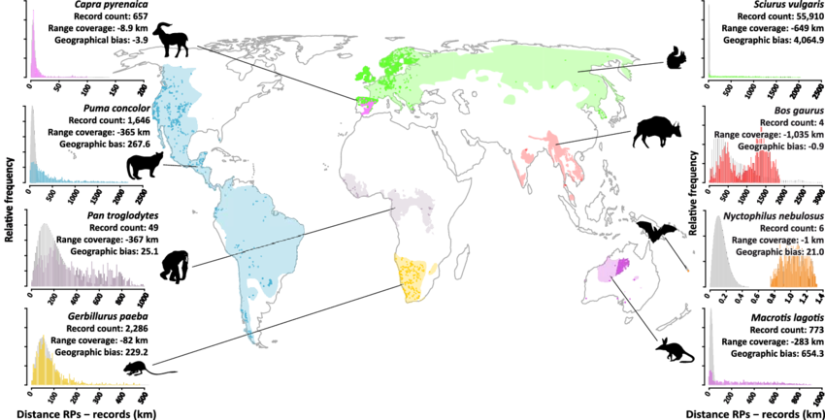
Observed records reflect sampling effort as well as biology
Meyer et al. (2016) Range geometry and socio-economics dominate species-level biases in occurrence information. Global Ecol. Biogeogr. 25: 1181-1193.

Slide 19
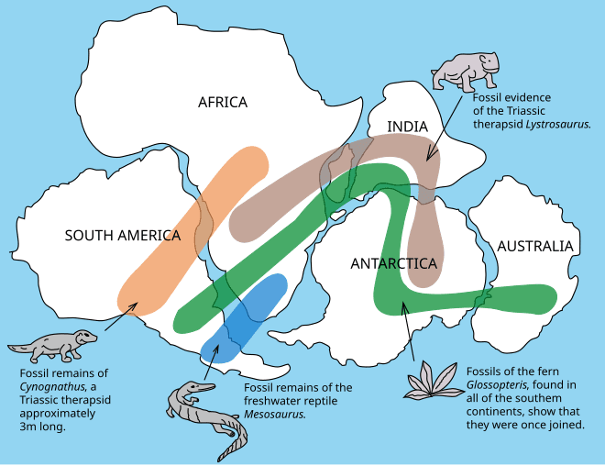
Geographic distributions
A lot of times people are thinking about range maps
Scale-dependent, coarse grain, broad extent
Presence of individuals, presence of reproductive populations, probability of detection within grid cells or polygons

Slide 20
Niches and Geographic Distributions
G-space
Geographic Space
Represented by points, grid cells, pixels, or polygons
Broad extent and coarse resolution, typically 1 km² per cell or more
E-space
Environmental Space
Suite of environmental attributes, such as climate, solar radiation, topography, and so on
Generally characterized in relatively coarse environmental variables

Slide 21
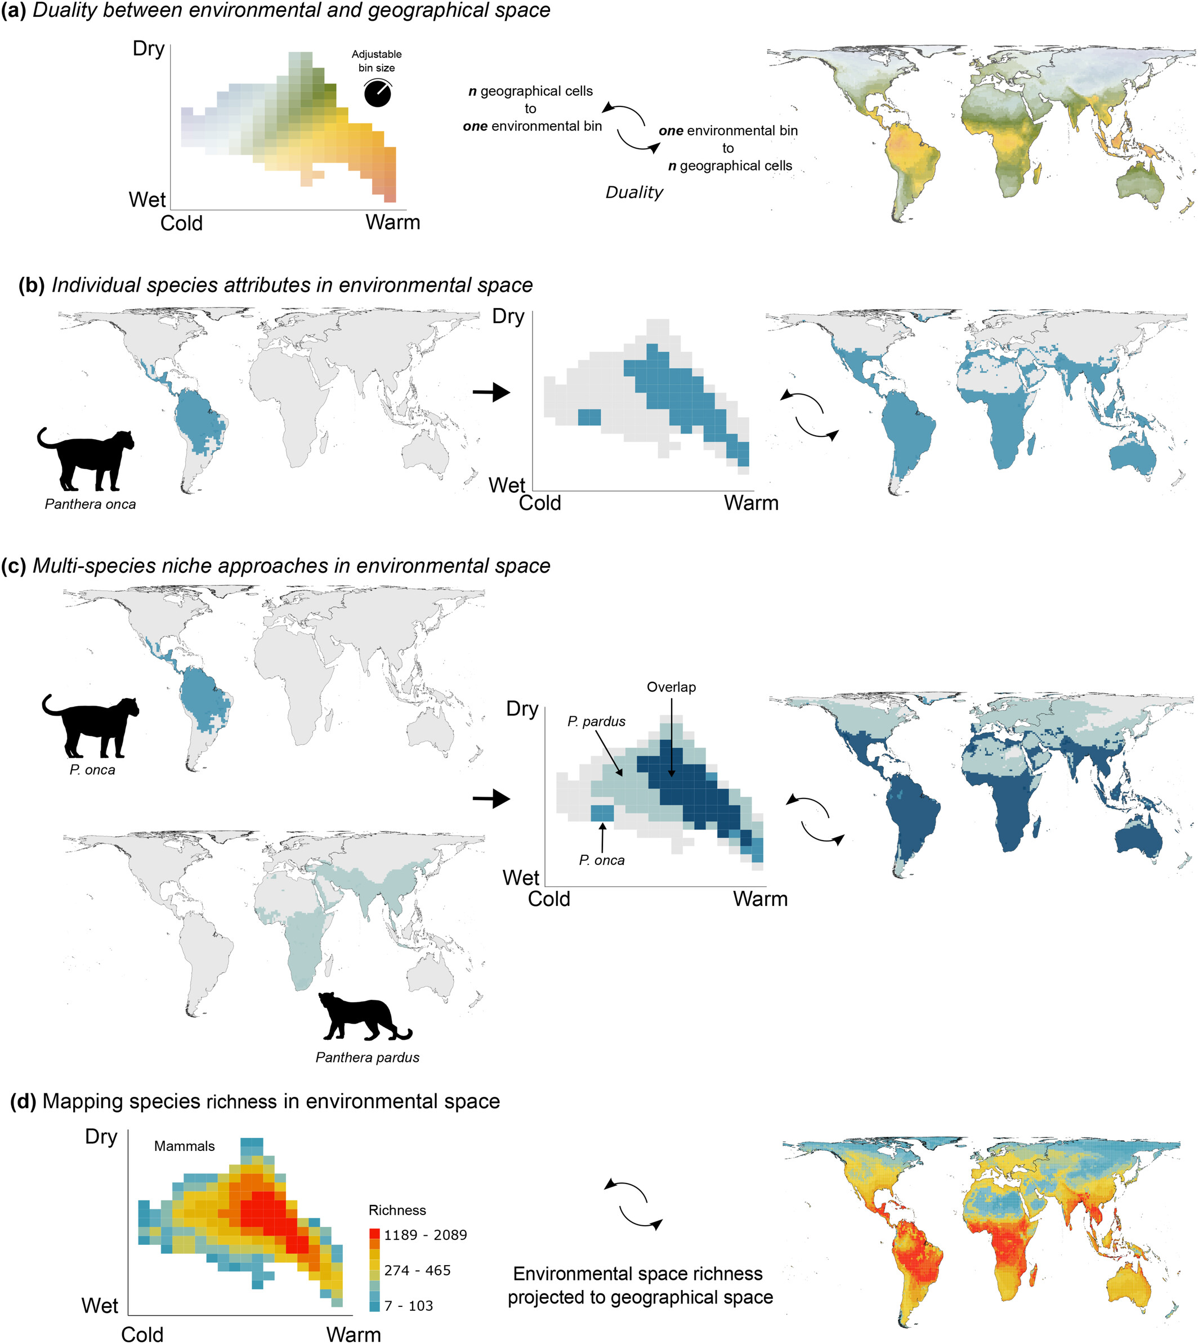
Hutchinson’s Duality of spaces
Graham et al. (2025) Biodiversity Patterns Redefined in Environmental Space. Ecology Letters. 28: e70008.

Slide 22
Hutchinson’s Duality of spaces
Graham et al. (2025) Biodiversity Patterns Redefined in Environmental Space. Ecology Letters. 28: e70008.

Slide 23
Biodiversity Patterns in Environmental Space
Graham et al. (2025) Biodiversity Patterns Redefined in Environmental Space. Ecology Letters. 28: e70008.

Slide 24
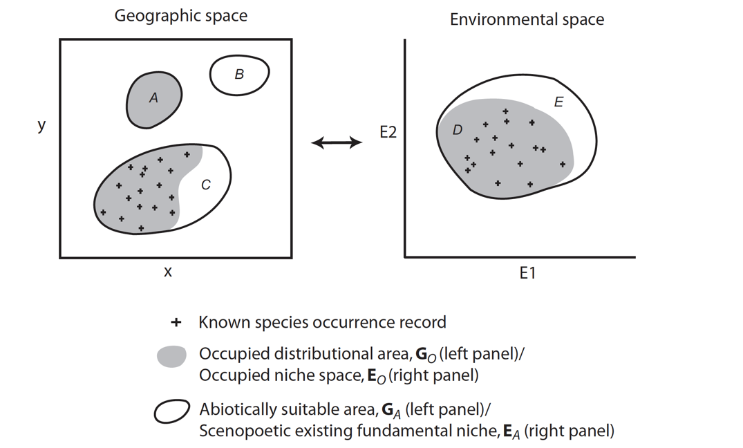
Hutchinson’s Duality of spaces (Peterson el al. 2011)
Spatial interpolation
Spatial transferability

Slide 25
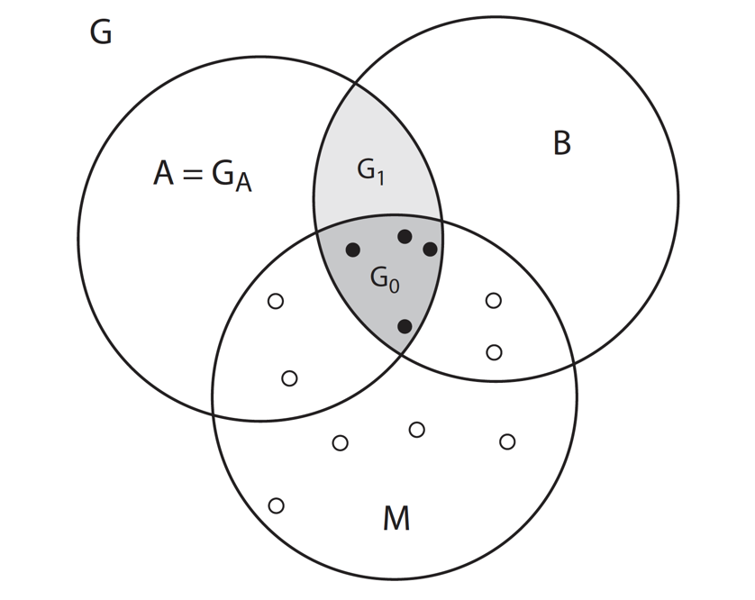
BAM Diagram (Figure 3.1)
Presence
Absence
G – Geographic
Space
B – Favorable Biotic
Factors
G_{A} – Abiotically
Suitable Area
A – Abiotic Factors
G_{I} – Invadable
Distributional Area
M – Movement Factors
G_{o} – Occupied
Distributional Area
G_{p} – Potential
Distribution (G_{I} + G_{o})

Slide 26
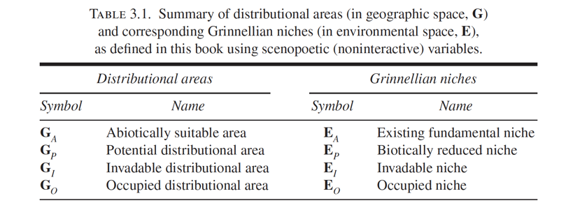
G-space corresponds to E-space

Slide 28
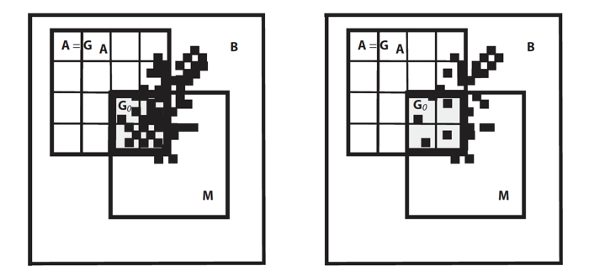
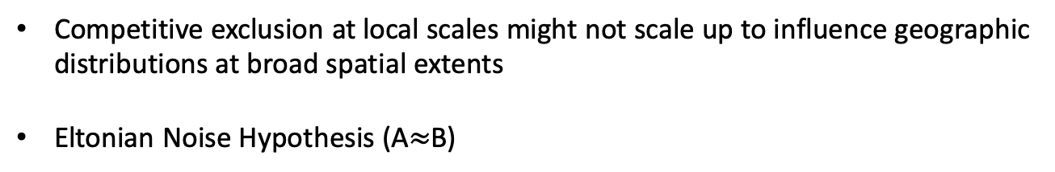
Biotically reduced niche (equivalent to realized niche)
Figure 3.3. BAM diagram redrawn to stress differences of spatial resolution in B versus A and M.
Competitive exclusion at local scales might not scale up to influence geographic distributions at broad spatial extents
Eltonian Noise Hypothesis (A$≈$B)

Slide 29
Estimating the fundamental niche, mechanistic niche models
Process-based physiological models
First principles of energy transfer and function to describe the ecological physiology of a species
Independent of correlative modeling approaches
Labor intensive laboratory work, so not readily available for a large number of species
Climate variables don’t always represent limiting physiological conditions
Suggested Reading: Kearney and Porter 2004, Buckley 2008

Slide 30
Estimating the fundamental niche, correlative approach
Estimate existing fundamental niche (E_{A}) from observations of presence of a species in relation to environmental variation
Presence-only data
Occupied distribution may be reduced from biotic interactions and/or dispersal limitations
Thinking about the configuration of BAM is important

Slide 31
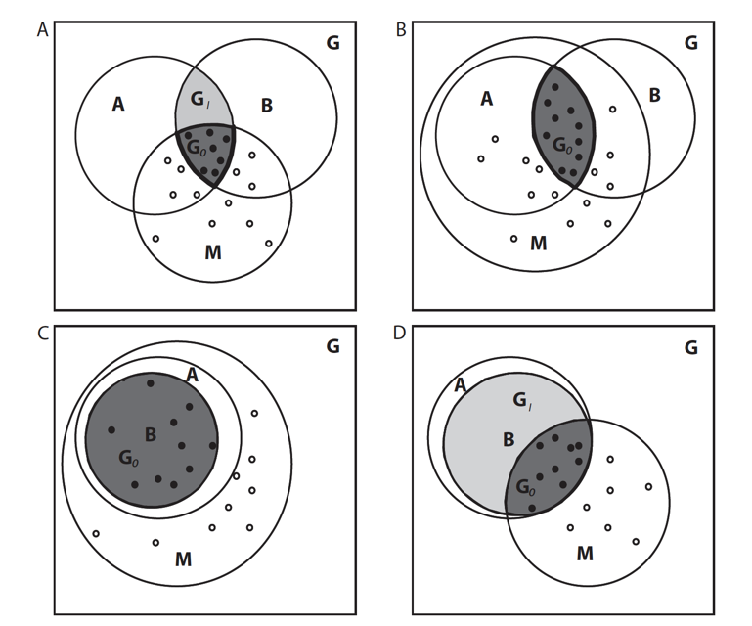
Different configurations of BAM
Limits on dispersal and biotically reduced
No limits on
dispersal and
biotically reduced
No limits on
dispersal and
Eltonian noise
Limits on
dispersal and
Eltonian noise
Figure 3.5

Slide 32
Occurrence data
When “true” absences are known
Typical statistical methods
Generalized Linear Modeling (GLM)
Generalized Additive Modeling (GAM)
Regression Trees
Models calibrated with presence and absence data are Species Distribution Models (SDM)
Most biodiversity datasets are presence-only data
Finding similar E to occupied E (E_{O}) in G-space
Ecological Niche Modeling (ENM)

